Slide 1

Using Yelp Dataset
Project Presentation 2
Follow our progress:
https://github.com/vanessailana/Machine_Learning_Projects-Fall-2019

Slide 2

Dataset Contents
6 csv files: business.csv, checkin.csv, photo.csv, review.csv, tip.csv, user.csv
Summing up all contents:
-semi structured some csv’s data is structured while other csv’s data is all over the place)

Slide 3

Agenda for Today
Looking at the data :
What type of data do we have?
Determining if the datasets we are using are structured, unstructured or semi structured?
Overall types of attributes we have
Looking at the data in python ide.

Slide 4
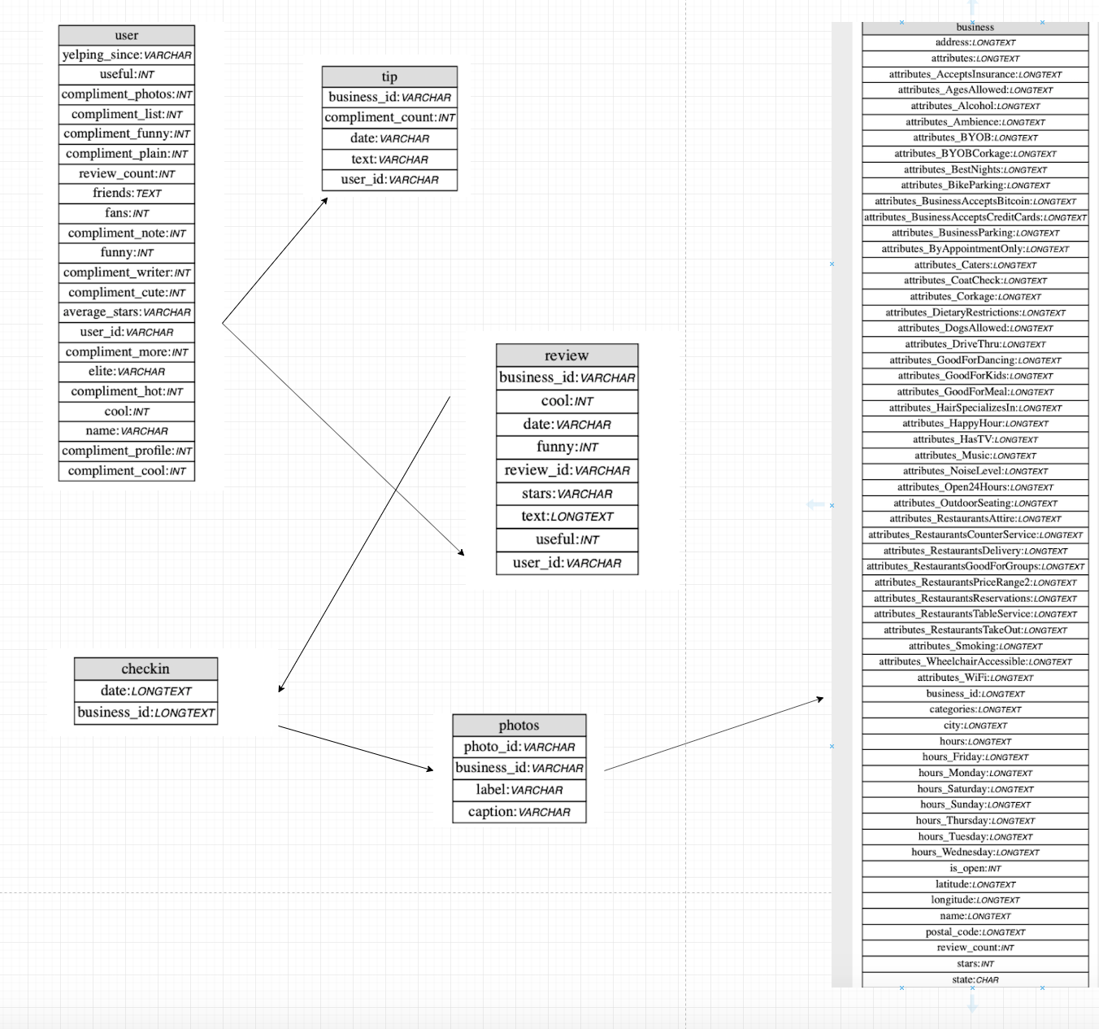
Entity Relational Diagram of Yelp Data:
How can we relate our datasets?

Slide 5
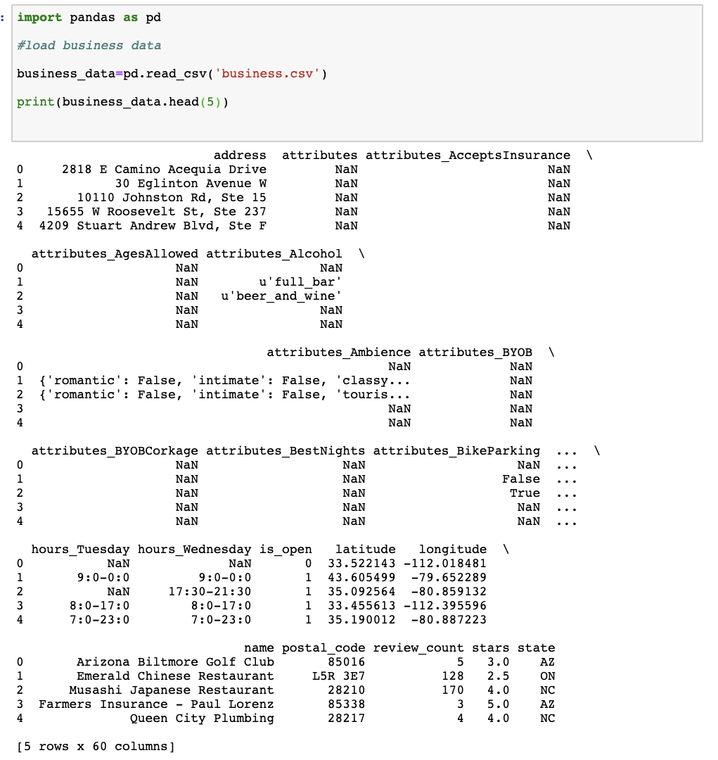
Business.csv
Data Type: Semi-Structured
Dataset Type: Record Data
Feature Attribute Types:
Mostly nominal attributes with the
Exception of:
Stars attribute is ordinal
Review_count is discrete
Is_open is a binary feature

Slide 6
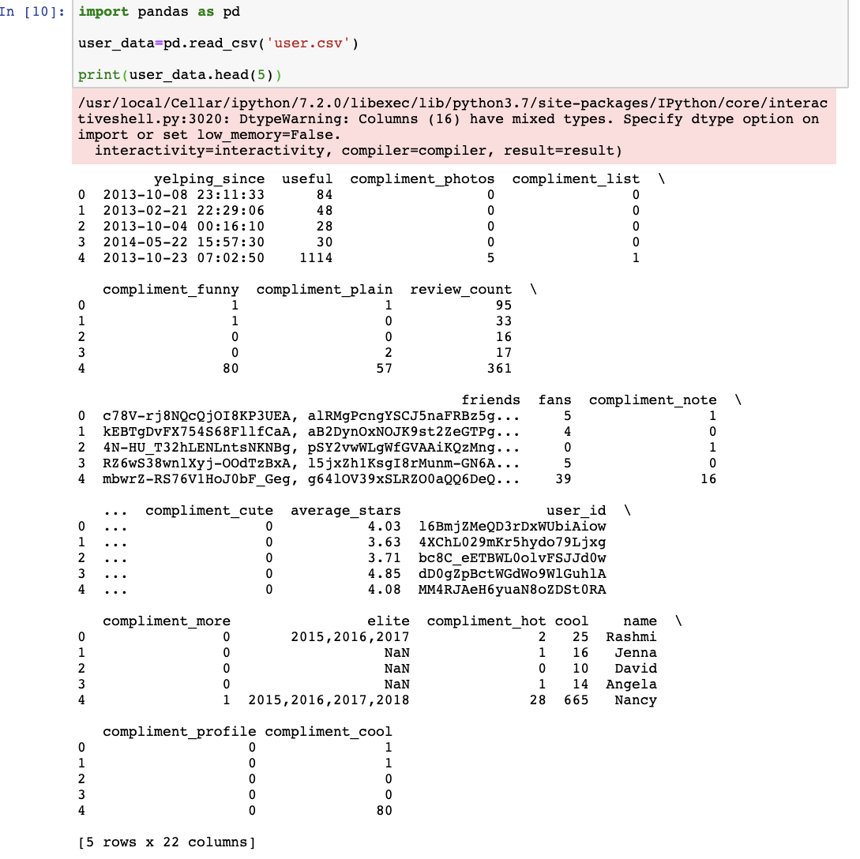
User.csv
Data Type: Structured
Dataset Type: Record Data
Feature Attribute Types:
Mostly nominal and discrete attributes with the
Exception of:
yelping since (Interval data)
Average_stars (continuous data)

Slide 7
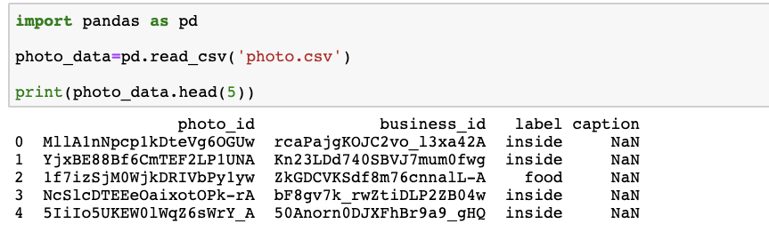
Photos.csv
Data Type: Structured
Dataset Type: Record Data
Feature Attribute Types:
Mostly nominal attributes with the
Exception of:
label (categorical data)

Slide 8
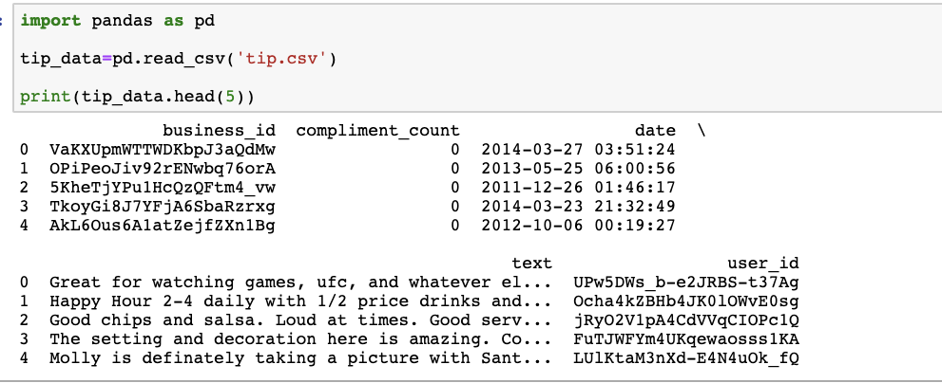
Tips.csv
Data Type: Semi-Structured
(one of the attributes is a document field aka text)
Dataset Type: Record Data
Feature Attribute Types:
Mostly nominal attributes with the exception of : -compliment_count which is discrete
Date is interval type.

Slide 9
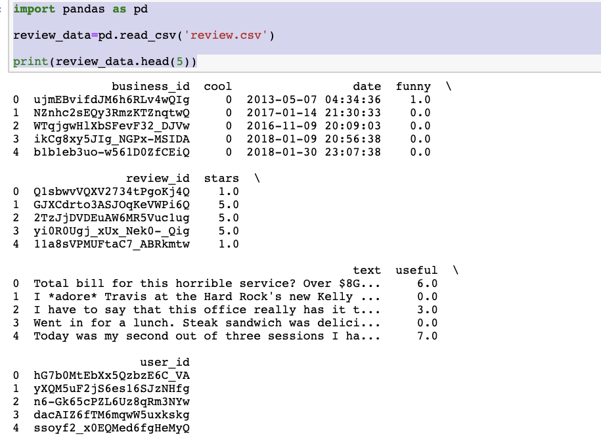
Review.csv
Data Type: Semi-Structured
(one of the attributes is a document field aka text)
Dataset Type: Record Data
Feature Attribute Types:
Mostly nominal attributes with the exception of :
Useful,cool,and funny which are discrete
Date is interval type.
Stars is ordinal

Slide 10
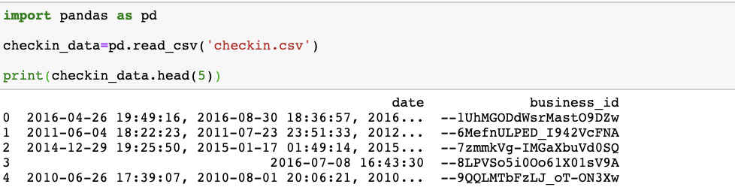
Check In.csv
Data Type: Structured
Dataset Type: Record Data
Feature Attribute Types: Nominal

Slide 11
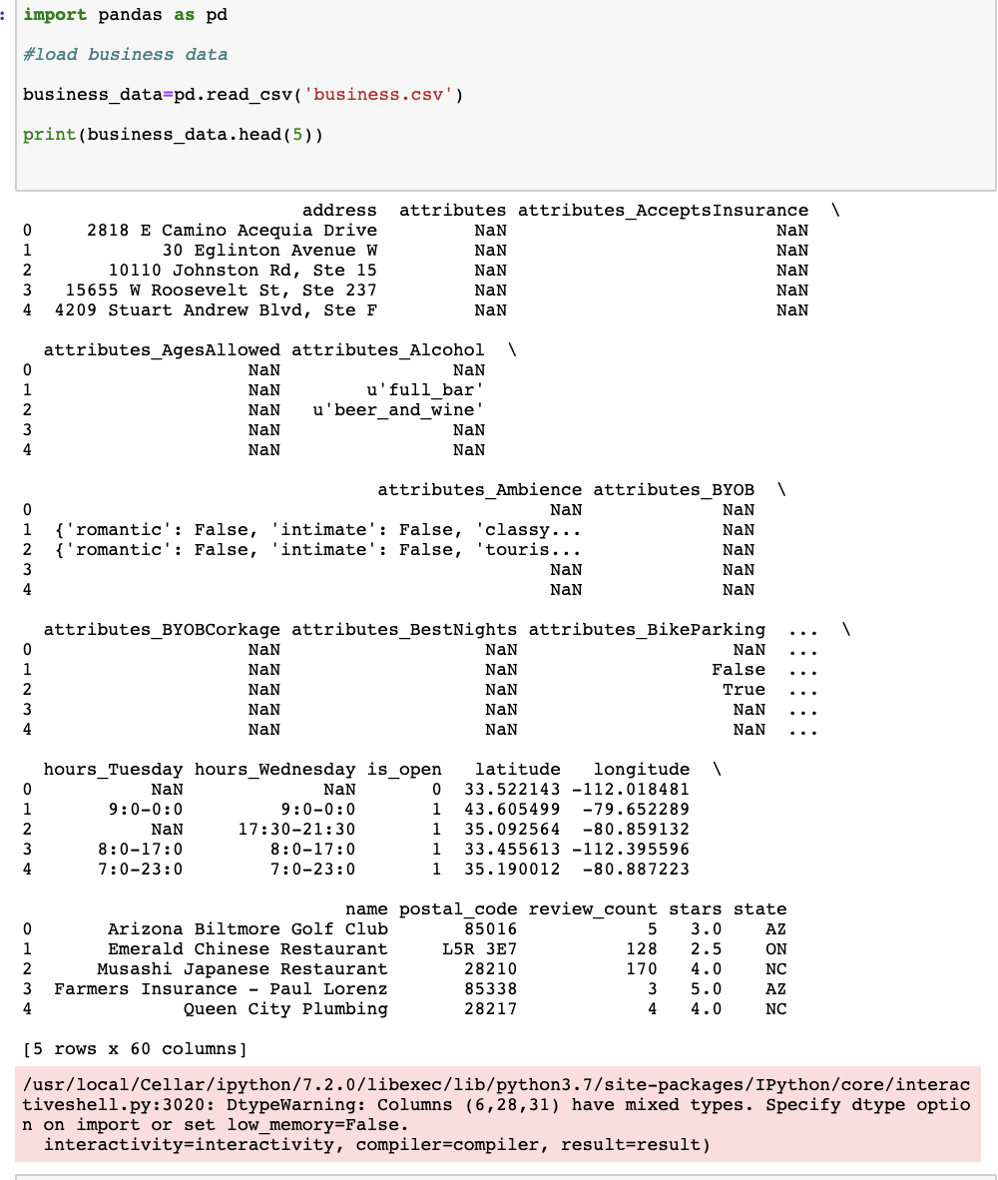
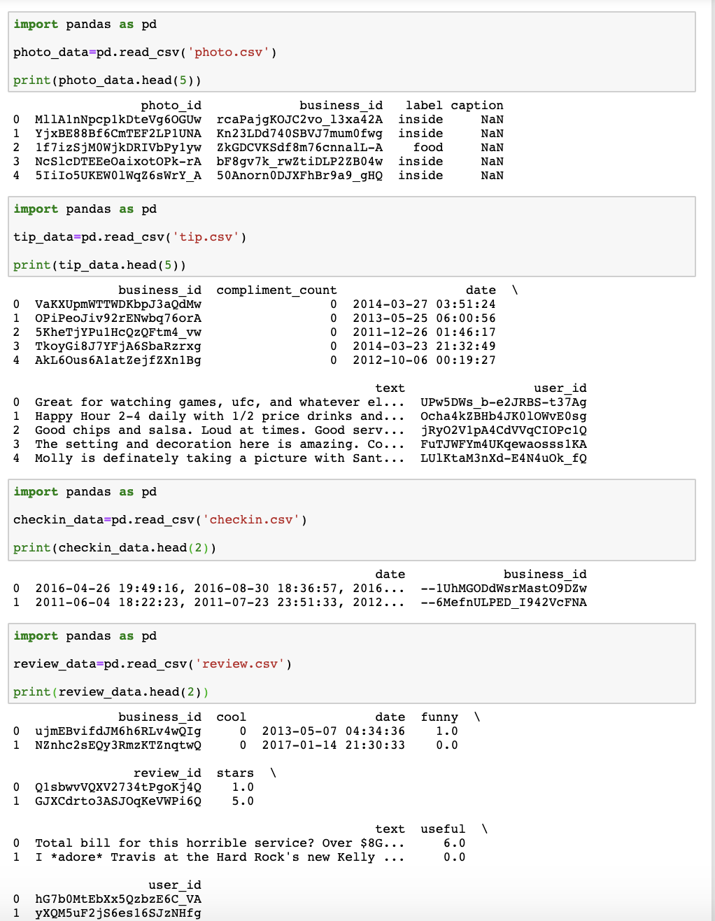

Slide 12
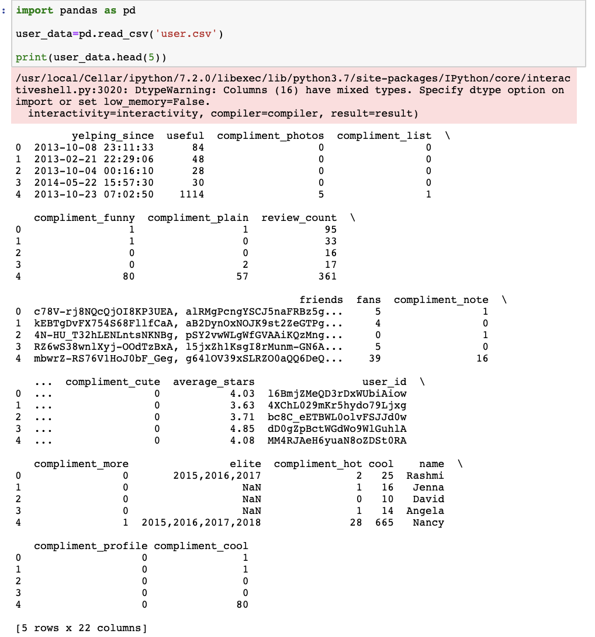

Slide 13

Did we have issues getting our data will our data help us achieve our requirements?
-We extracted our datasets from https://www.yelp.com/dataset/challenge . The only dilemma we had with this data set is that when we downloaded it via yelp all files were in json format. So, we have to convert the essential dataset(s) into a .csv format by creating a python script.
- The data that we are utilizing to compute our ML tasks, satisfies the requirements of what we want to accomplish. The biggest concern we have is that the business table
needs to be restructured and we need to analyze what is the best way to preprocess data in this table and how we can transform features in a clean manner.

Slide 14
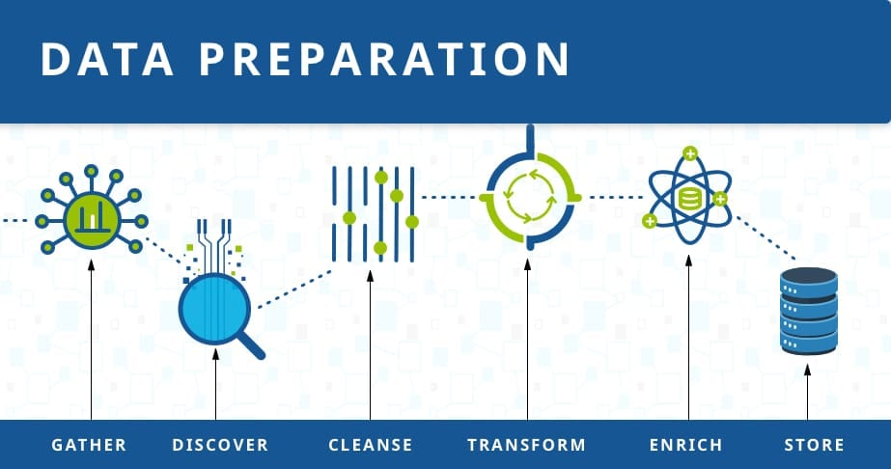
Next Steps:
Data Collection ✓
Data Preparation
Choose a Model
Train the Model
Evaluate the Model
Hyperparameter tuning
Make predictions
Deploy
Discuss Plan for future Maintenance and how we can get real time predictions (things like Kafka)

